Slide 1
Analysis of Categorical Data II
Statistical Data Analysis, 2023

Slide 2

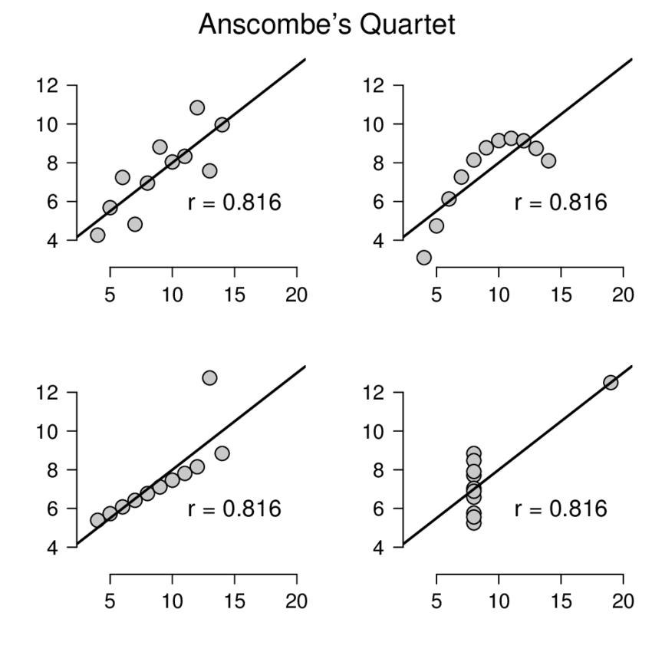
Why plotting is important
https://github.com/jumpingrivers/datasauRus
## R package:
install.packages("datasauRus")

Slide 3
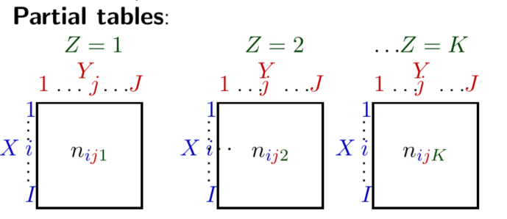
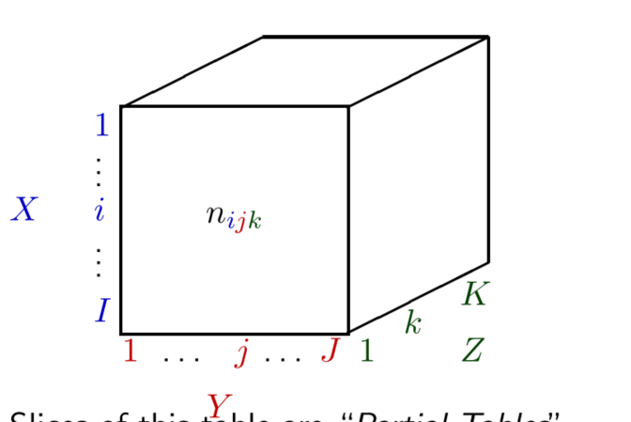

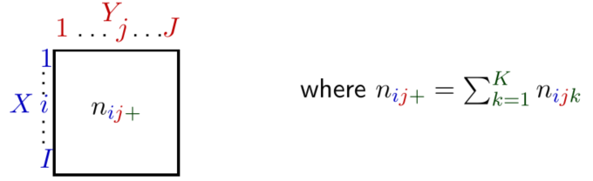
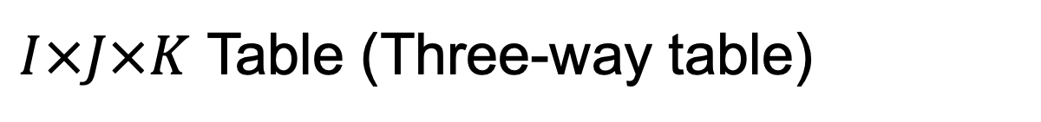
$I×J×K$ Table (Three-way table)

Slide 4
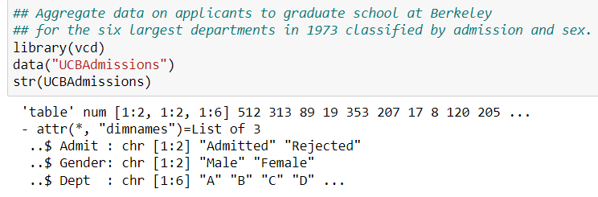
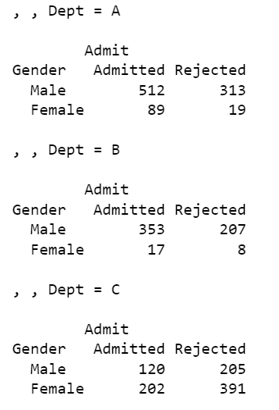
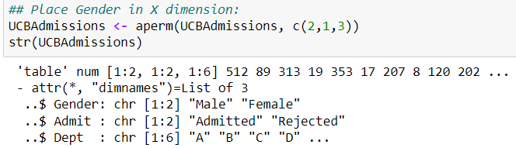
Example: UCB Admission
Partial table:
…

Slide 5
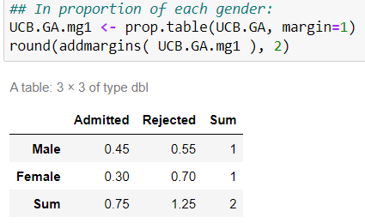
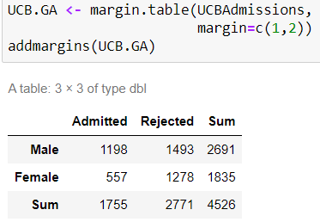
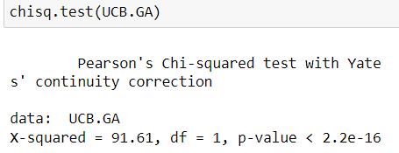
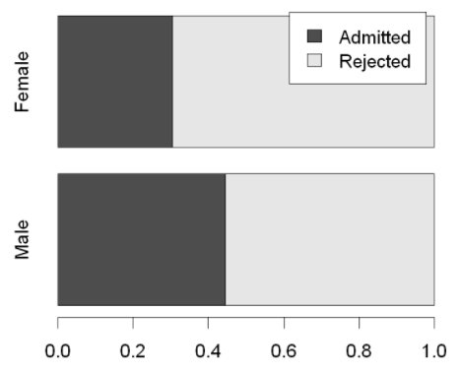
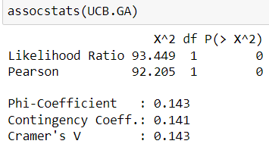
Example: UCB Admission
Marginal table:
Still not so intuitive…
Q: Gender bias?
Notes:
Cramer’s V = 0.14 : small association, but non-negligible

Slide 6
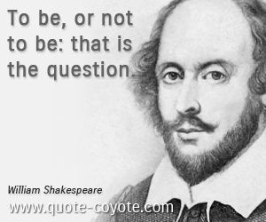
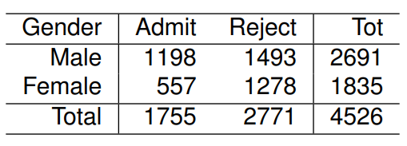
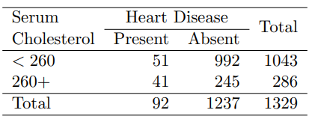
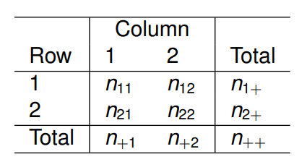
2x2 Contingency Table
Many discrete variables are binary, so 2x2 tables are very common.
Worthwhile to consider separately.
response
stratified
…
explanatory
2x2 table
2x2xk table

Slide 7
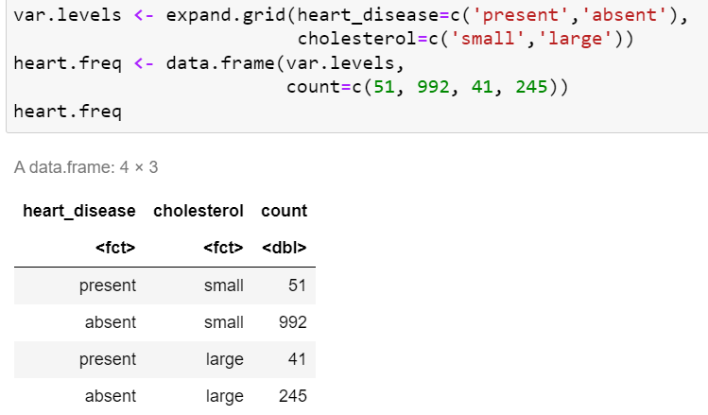
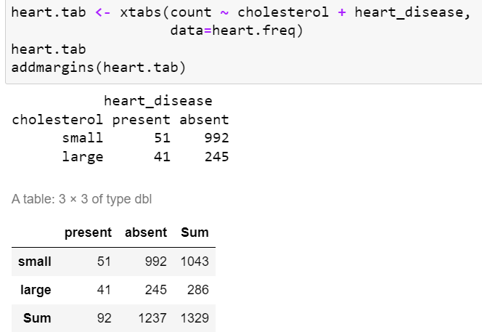
Technical: Manually input a table in R

Slide 8
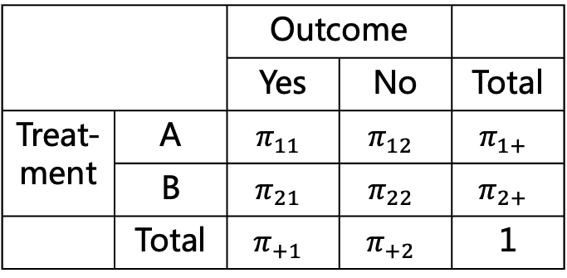
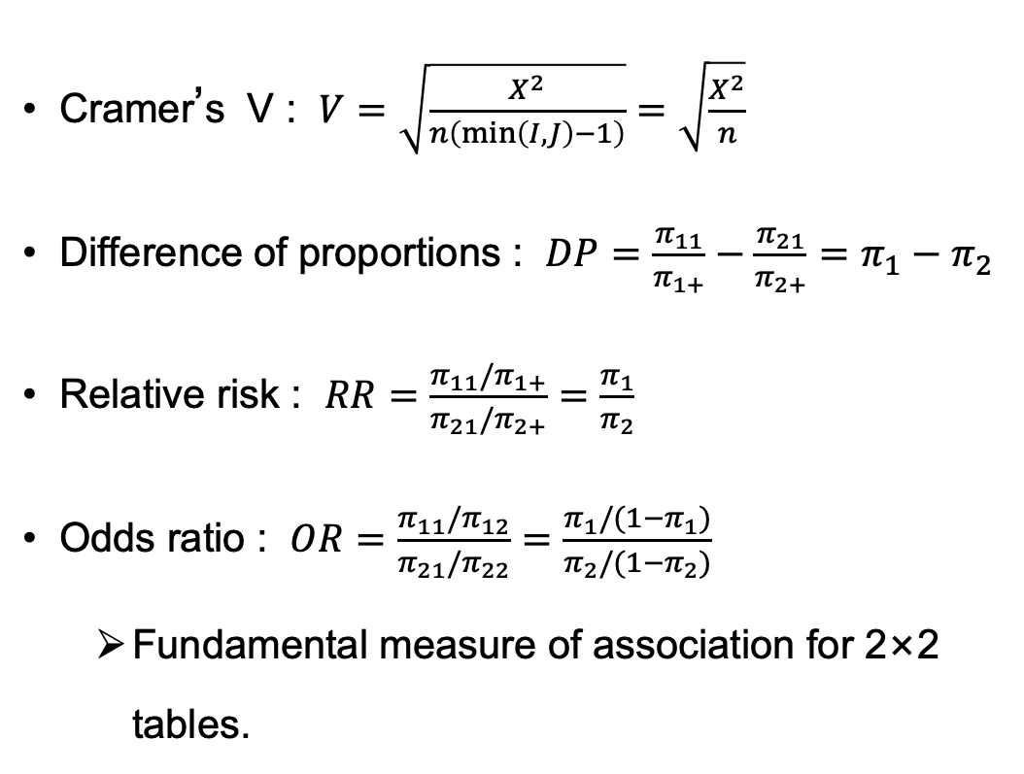
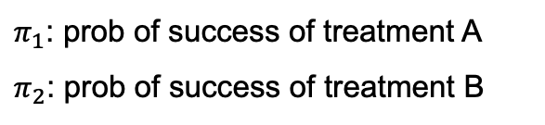
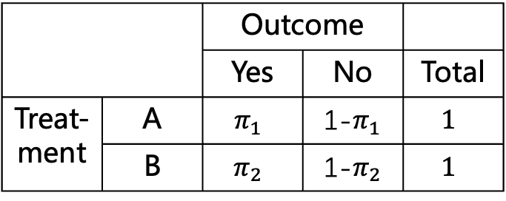
2x2 Contingency Table – measure of association
Cramer’s V : $V=\sqrt{\frac{X^{2}}{n\left(\min\left(I,J\right)−1\right)}}=\sqrt{\frac{X^{2}}{n}}$
Difference of proportions : $DP=\frac{π_{11}}{π_{1+}}−\frac{π_{21}}{π_{2+}}=π_{1}−π_{2}$
Relative risk : $RR=\frac{π_{11}/π_{1+}}{π_{21}/π_{2+}}=\frac{π_{1}}{π_{2}}$
Odds ratio : $OR=\frac{π_{11}/π_{12}}{π_{21}/π_{22}}=\frac{π_{1}/(1−π_{1})}{π_{2}/(1−π_{2})}$
Fundamental measure of association for 2×2 tables.
 |  | Outcome
 |  | Yes | No | Total
Treat-ment | A | $$π_{11}$$ | $$π_{12}$$ | $$π_{1+}$$
 | B | $$π_{21}$$ | $$π_{22}$$ | $$π_{2+}$$
 | Total | $$π_{+1}$$ | $$π_{+2}$$ | 1
Conditioned on treatment
 |  | Outcome
 |  | Yes | No | Total
Treat-ment | A | $$π_{1}$$ | 1-$π_{1}$ | $$1$$
 | B | $$π_{2}$$ | 1-$π_{2}$ | $$1$$
?
$π_{1}$: prob of success of treatment A
$π_{2}$: prob of success of treatment B

Slide 9
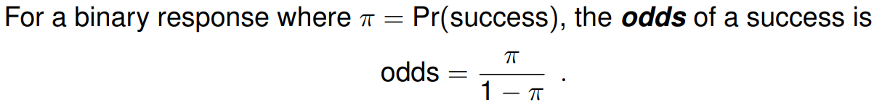
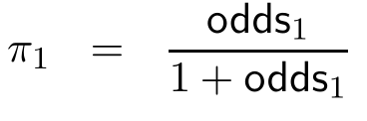
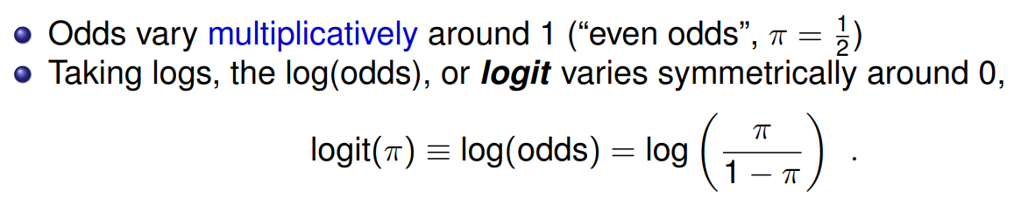
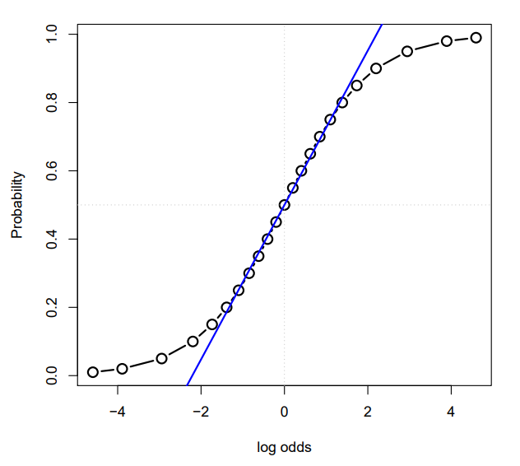
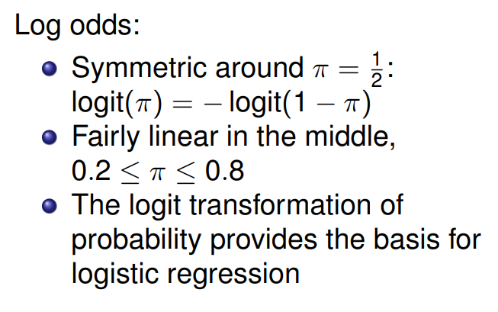
Odds
Notes:
English: what are the odds of…

Slide 10
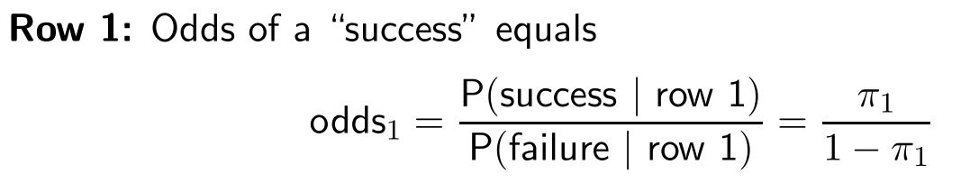
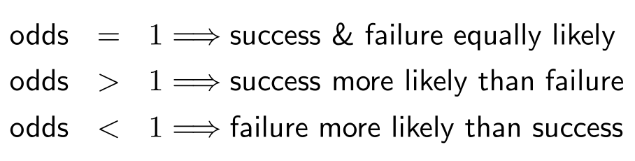
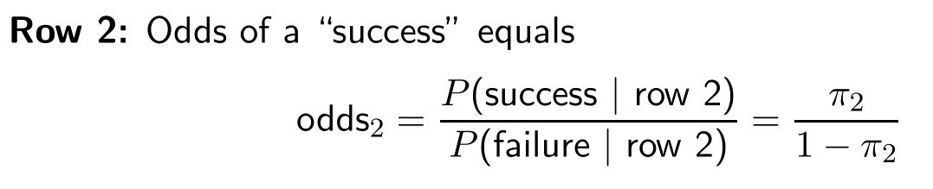
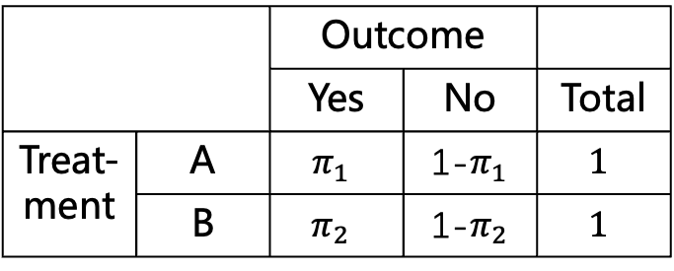
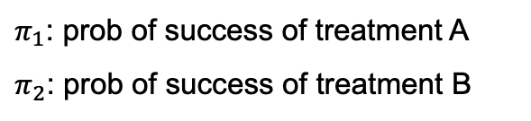
Odds
 |  | Outcome
 |  | Yes | No | Total
Treat-ment | A | $$π_{1}$$ | 1-$π_{1}$ | $$1$$
 | B | $$π_{2}$$ | 1-$π_{2}$ | $$1$$
$π_{1}$: prob of success of treatment A
$π_{2}$: prob of success of treatment B

Slide 11
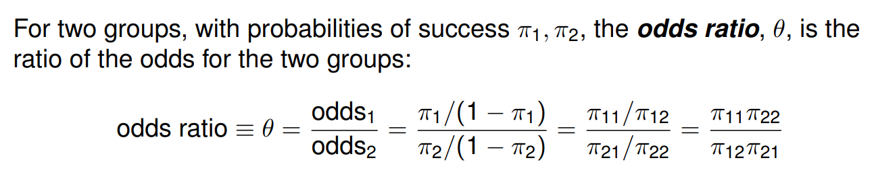
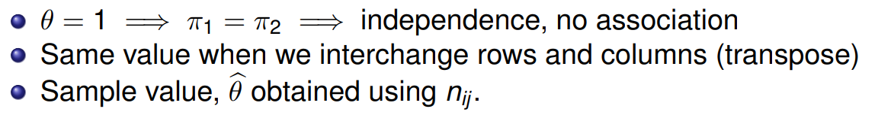
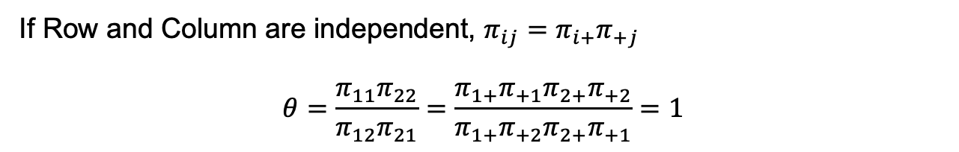
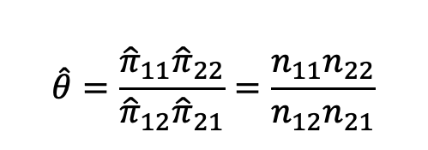
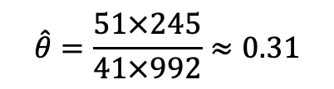
Odds Ratio
If Row and Column are independent, $π_{ij}=π_{i+}π_{+j}$
$$θ=\frac{π_{11}π_{22}}{π_{12}π_{21}}=\frac{π_{1+}π_{+1}π_{2+}π_{+2}}{π_{1+}π_{+2}π_{2+}π_{+1}}=1$$
Example:
$$\hat{θ}=\frac{{\hat{π}}_{11}{\hat{π}}_{22}}{{\hat{π}}_{12}{\hat{π}}_{21}}=\frac{n_{11}n_{22}}{n_{12}n_{21}}$$
$$\hat{θ}=\frac{51×245}{41×992}≈0.31$$

Slide 12
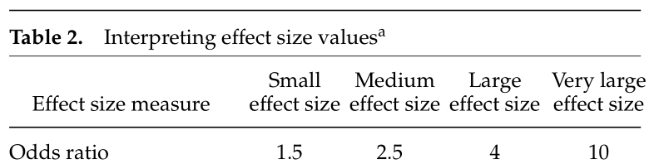
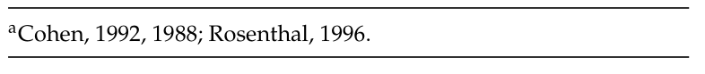
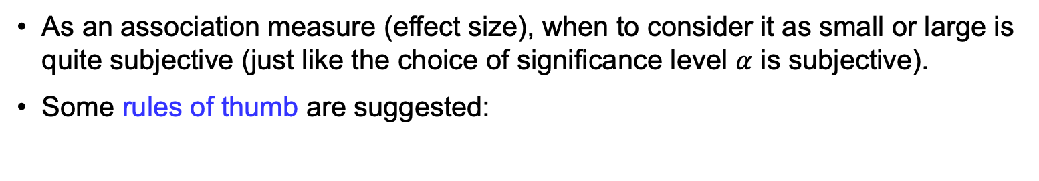
Odds Ratio
As an association measure (effect size), when to consider it as small or large is quite subjective (just like the choice of significance level $α$ is subjective).
Some rules of thumb are suggested:
Q: what if
odds ratio < 1 ?
https://imaging.mrc-cbu.cam.ac.uk/statswiki/FAQ/effectSize

Slide 13
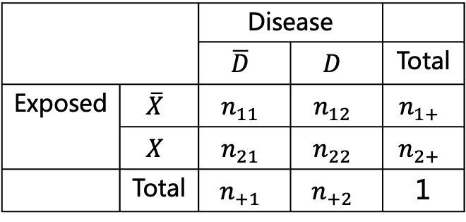
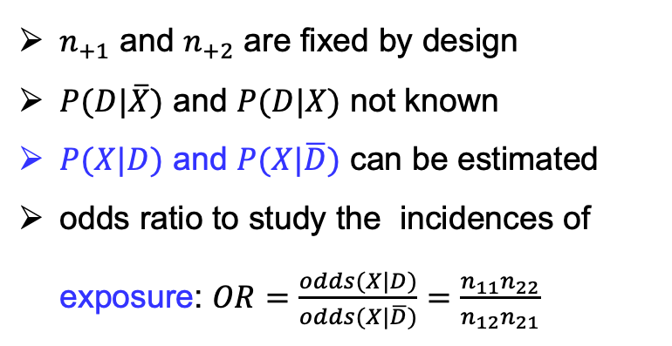
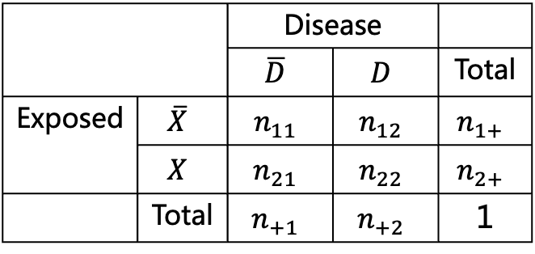
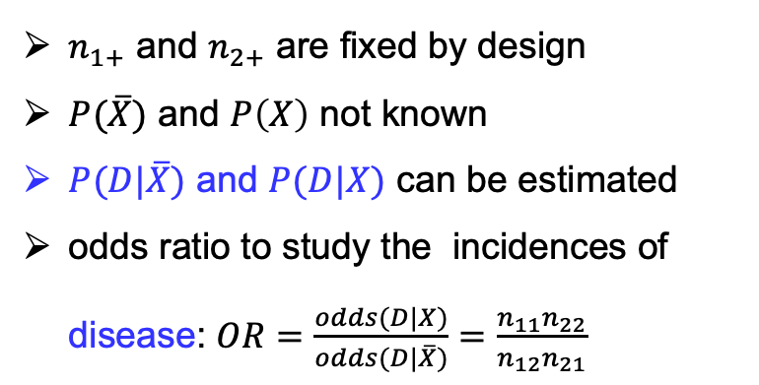
Odds Ratio – Advantage
Applicable to different sampling schemes. E.g., in epidemiology:
Prospective study
Retrospective case-control study
← Gain Popularity as case-control study is less expansive.
 |  | Disease
 |  | $$\overline{D}$$ | $$D$$ | Total
Exposed | $$\overline{X}$$ | $$n_{11}$$ | $$n_{12}$$ | $$n_{1+}$$
 | $$X$$ | $$n_{21}$$ | $$n_{22}$$ | $$n_{2+}$$
 | Total | $$n_{+1}$$ | $$n_{+2}$$ | 1
 |  | Disease
 |  | $$\overline{D}$$ | $$D$$ | Total
Exposed | $$\overline{X}$$ | $$n_{11}$$ | $$n_{12}$$ | $$n_{1+}$$
 | $$X$$ | $$n_{21}$$ | $$n_{22}$$ | $$n_{2+}$$
 | Total | $$n_{+1}$$ | $$n_{+2}$$ | 1
$n_{1+}$ and $n_{2+}$ are fixed by design
$P(\overline{X})$ and $P\left(X\right)$ not known
$P(D|\overline{X})$ and $P(D|X)$ can be estimated
odds ratio to study the incidences of disease: $OR=\frac{odds(D|X)}{odds(D|\overline{X})}=\frac{n_{11}n_{22}}{n_{12}n_{21}}$
$n_{+1}$ and $n_{+2}$ are fixed by design
$P(D|\overline{X})$ and $P(D|X)$ not known
$P(X|D)$ and $P(X|\overline{D})$ can be estimated
odds ratio to study the incidences of exposure: $OR=\frac{odds(X|D)}{odds(X|\overline{D})}=\frac{n_{11}n_{22}}{n_{12}n_{21}}$
← Roughly estimates the relative risk for rare disease.
Notes:
Prospective for Rare disease, need to sample many people of exposed and non-exposed.

Slide 14
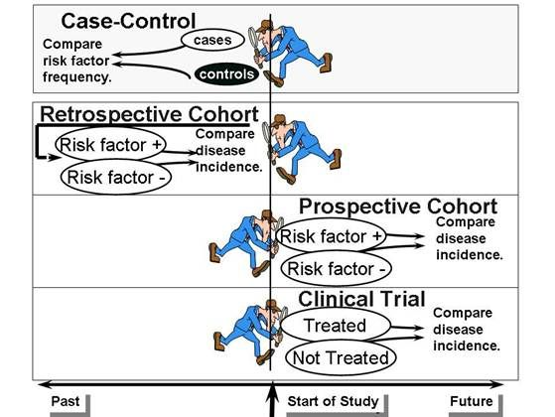
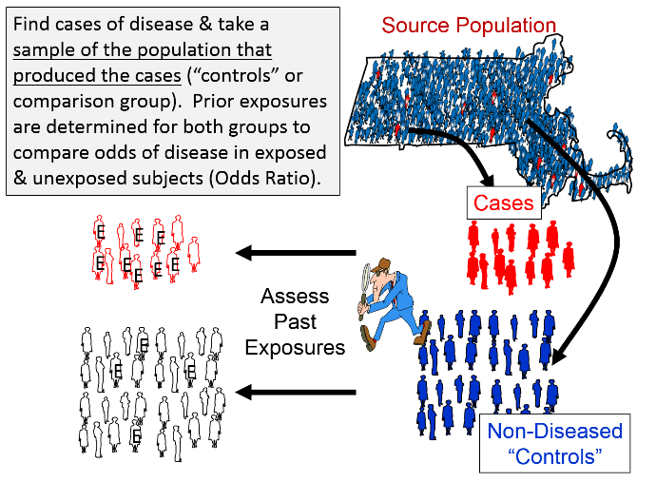
Different studies
case-control study

Slide 15
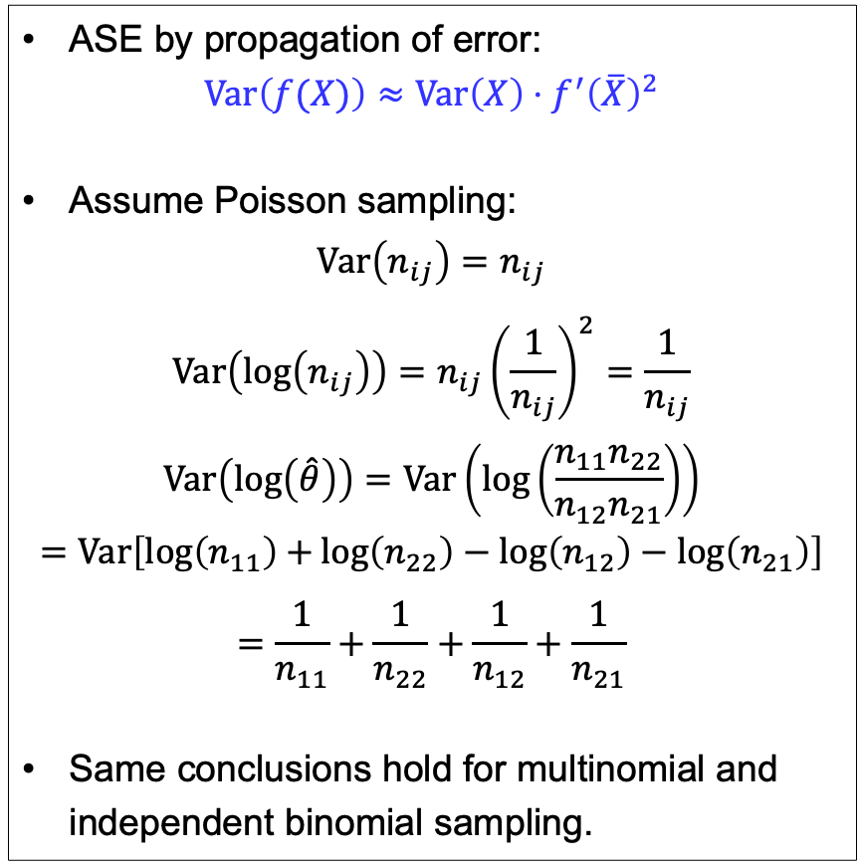
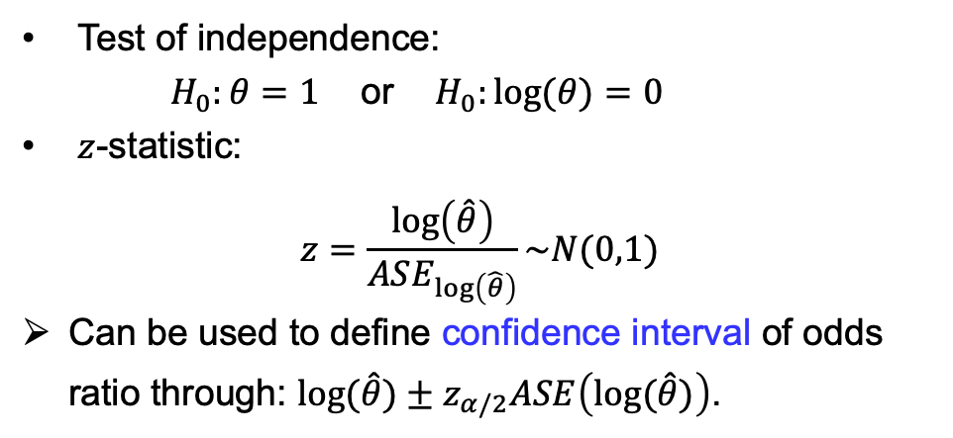
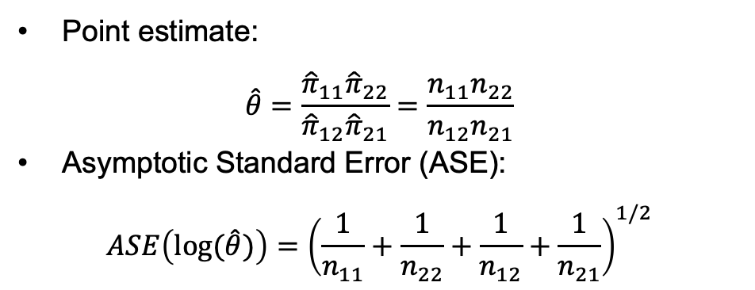
Odds ratios – Statistical inference
Point estimate:
$$\hat{θ}=\frac{{\hat{π}}_{11}{\hat{π}}_{22}}{{\hat{π}}_{12}{\hat{π}}_{21}}=\frac{n_{11}n_{22}}{n_{12}n_{21}}$$
Asymptotic Standard Error (ASE):
$$ASE\left(\log{(\hat{θ})}\right)={\left(\frac{1}{n_{11}}+\frac{1}{n_{22}}+\frac{1}{n_{12}}+\frac{1}{n_{21}}\right)}^{1/2}$$
ASE by propagation of error:
$$Var\left(f(X)\right)≈Var\left(X\right)⋅f^{′}{\left(\overline{X}\right)}^{2}$$
Assume Poisson sampling:
$$Var\left(n_{ij}\right)=n_{ij}$$
$$Var\left(\log\left(n_{ij}\right)\right)=n_{ij}{\left(\frac{1}{n_{ij}}\right)}^{2}=\frac{1}{n_{ij}}$$
$$Var\left(\log\left(\hat{θ}\right)\right)=Var\left(\log\left(\frac{n_{11}n_{22}}{n_{12}n_{21}}\right)\right)$$
$$=Var\left[\log\left(n_{11}\right)+\log\left(n_{22}\right)−\log\left(n_{12}\right)−\log\left(n_{21}\right)\right]$$
$$=\frac{1}{n_{11}}+\frac{1}{n_{22}}+\frac{1}{n_{12}}+\frac{1}{n_{21}}$$
Same conclusions hold for multinomial and independent binomial sampling.
Test of independence:
$H_{0}:θ=1$ or $H_{0}:\log{(θ)}=0$
$z$-statistic:
$$z=\frac{\log\left(\hat{θ}\right)}{ASE_{\log\left(\hat{θ}\right)}}\sim N(0,1)$$
Can be used to define confidence interval of odds ratio through: $\log{(\hat{θ})}±z_{α/2}ASE\left(\log{(\hat{θ})}\right)$.

Slide 16



P-value and Effect size — Small and Big Data
Statistically significant (at 0.05 level)
Sample size: 40
p-value: 0.058
(chi-squared test)
Odds ratio: 3.45
Sample size: 80
p-value: 0.0073
(chi-squared test)
Odds ratio: 3.45
Sample size: 20000
p-value: 0.0047
(chi-squared test)
Odds ratio: 1.08
Medium effect
Notes:
Big data: (traditional) hypothesis testing not so useful.
Question: is sample size 80 enough for a clinical trial ?
Will you trust the treatment based on sample size of 80, but have very stat. significant results ?

Slide 17


Example: UCB Admission
Odds ratio in R
Marginal table:
The odds of male being admitted is 1.84 times as large as the odds of female being admitted.
The independence hypothesis $H_{0}:θ=0$ is rejected at 5% significance level.
Same conclusion as chi-square test, but simultaneously give the association measure.
Notes:
Confirming gender bias ?

Slide 18

3-way table – UCB Admission
Odds ratio for each department
Wait, is gender the only factor associated with admission?
stratified by department
(in fact, the original table…)
…
Observation:
4 out of 6 depts have odds ratios smaller than 1 (in favor of female). → No gender bias ?
Except for Department A, the odds ratio (association between gender and admission) for each department is close to 1. → Statistically significant ?
→ Contradiction to previous results?
Notes:
Need to deal with 2nd point first: is the deviations of odds ratio from 1 due to random fluctuation ?

Slide 19





3-way table – Conditional independence
Notion of marginal and conditional independence
Odds ratio conditioned on the k-th stratum:
$$θ_{XY(k)}=1$$
$$⟺$$
$$P\left(X,Y | Z=k\right)=$$
$$P(X|Z=k)P(Y|Z=k)$$
Notes:
Marginal independence does not imply conditional independence.
Conditional independence does not imply marginal independence.

Slide 20





3-way table – Test of conditional independence
Cochran-Mantel-Haenszel (CMH) Test for conditional independence (for 2x2xK table):
For large samples, when $H_{0}$ is true, CMH statistics has a chi-squared distribution with df = 1.
Implying conditional independence
$P\left(G,A | D\right)=P\left(G | D\right)P\left(A | D\right)$?
Notes:
Why use only n_11: under the independence assumption, only 1 df.
If the conditional independence holds:
for each department, there is no gender bias; so there is no gender bias.

Slide 21

CMH Test – Assumption of homogeneous association
To be cautious:
The Cochran-Mantel-Haenszel test is based on the assumption of homogeneous association (odds ratios do not differ a lot in different strata), or equivalently, there is no 3-way association.
But we notice an outstanding odds ratio in Department A
More formal test of homogeneous association:
Woolf test or Breslow–Day test
Strictly speaking, the previous result of CMH test is not very reliable.
We should take it as a hint (but not evidence), and investigate further.
What else methods can we used?
Notes:
Q: why the confidence intervals of odds ratio do not provide a definite answer of homo assoc?
A: depending on the sampling schemes, counts on different stratum can be correlated.
What else methods ?
-> There are still many hypothesis testing method to use, but quickly becomes very complicated when the contingency table becomes large.
-> graphing (datasauRus…) + model-based analysis

Slide 22


3-way table – UCB Admission – Graphing
Gender-Dept → Plot (1, 3)
much more males applied to Department A, B
Admit-Dept → Plot (2, 3)
Department A, B had higher admittance rates than others
Department F had a very low admittance rates
Notes:
Pairs: like pairs for scatter plots.
Diagonal: overall feeling of each attribute.
Advantage: no need to manually create marginal tables.

Slide 23

3-way table – UCB Admission – Graphing
Except for Department A, the acceptance rates are close for M and F (same conclusion as odds ratio).
Department A, B are dominated by male applicants.
Department F had a very low admittance rates…
Notes:
Confirming the conclusion from odds ratio: only Dept A is significant;
But also show additional information: the size bias in Dept A, B.
What is Dept F ???

Slide 24




3-way table – UCB Admission
Conditioned on each stratum, only Dept A shows a significant association between Gender and Admit
Odds ratio for the marginal 2x2 table
$${\hat{θ}}_{XY}=1.84$$
$$95\% CI=(1.62, 2.09)$$
Odds ratio for the partial 2x2 table conditioned on Dept A
$${\hat{θ}}_{XY(Z=A)}=0.35$$
$$95\% CI=(0.21, 0.58)$$
An example of the Simpson’s paradox

Slide 25


3-way table – UCB Admission – More graphing and intuition
Reason for the “paradox” in this example: females tended to apply for more competitive departments with lower rates of admission.
No significant gender bias revealed in this data.
But is there a deeper societal reason why much less females applied to Dept A, B? Maybe anther story.
Notes:
To have an intuition why the “paradox” happen.
No apparent bias in admission rate, but big difference in application rates.

Slide 26
More on Simpson’s Paradox (Optional)

Slide 27




3-way table – Simpson’s paradox
Partial frequency tables
Z=1 |  | Y
 |  | 1 | 2
X | 1 | a | b
 | 2 | c | d
Z=2 |  | Y
 |  | 1 | 2
X | 1 | e | f
 | 2 | g | h
It is possible that
$\frac{a}{b}>\frac{c}{d}$ and $\frac{e}{f}>\frac{g}{h}$ ,
while $\frac{a+e}{b+f}<\frac{c+g}{d+h}$
Notes:
Simpson’s paradox -> very easy to get misleading conclusion.
Worthwhile to closely investigate.
Mathematically totally legitimate, why still so paradoxical ?

Slide 28
3-way table – Simpson’s paradox – Example
Partial frequency tables
Marginal frequency tables
Z Gender = Male |  | Y
 |  | Recover | Not recover | Rec. rate
X | Drug | 1800 | 1200 | 60%
 | No drug | 700 | 300 | 70%
Marginal |  | Y
 |  | Recover | Not recover | Rec. rate
X | Drug | 2000 | 2000 | 50%
 | No drug | 1600 | 2400 | 40%
Z Gender = Female |  | Y
 |  | Recover | Not recover | Rec. rate
X | Drug | 200 | 800 | 20%
 | No drug | 900 | 2100 | 30%

Slide 29


投票
最多可选1项
If a new patient come, should you recommend him/her to take the drug ?
A
Yes
B
No
C
Not sure
提交

Slide 30



3-way table – Simpson’s paradox – Example
The "paradox" occurs because we are asking a causal (interventional) question – If we give someone the drug, what happens ?
(This is not a pure mathematical game, but also involved in serious decision making.)
Note that, this is an observational calculation.
There is a difference between "given that we see" (observational evidence) and "given that we do" (interventional evidence).
In these two examples, gender and stone size appear to be the confounding (lurking) variables.
Z Gender = Male Gender = Female Combined |  | Y
 |  | Recover | Not recover | Rec. rate
X | Drug | 1800 200 2000 | 1200 800 2000 | 60% 20% 50%
 | No drug | 700 900 1600 | 300 2100 2400 | 70% 30% 40%
More on the topic (a proper Bayesian treatment):
J. Pearl - Causal Inference in Statistics: A Primer
D. Barber - Bayesian Reasoning and Machine Learning (free online)
[Charig et al, 1986]
Notes:
The intuition for a higher combined rec. rate:
(i) Gender: in the PAST, males were more often given drugs, and they were easier to cure.
(ii) Stone size: in the PAST, treatment B was given more often to the easier group (small stones).
This is in fact a bad sampling (or no way to control how the data is sampled, like the UCB Admission case).
But right now, we don’t care about what had been wrong in the past.
Pearl’s do calculus, want P(R|D) while blocking the influence P(D|G).
D. Barber’s book is a good reference to Bayesian analysis on related subjects.

Slide 31



投票
最多可选1项
You observe an overall negative correlation between basketball success and training time. For a newcomer, will you recommend more training to him/her ?
A
Yes
B
No
C
Not sure
training time
提交
Notes:
In the PAST, happened to ask the older group to train more.

Slide 32


Simpson’s Paradox
Categorical variable
Continuous variable
$\frac{a}{b}>\frac{c}{d} \left(θ_{XY(1)}>1\right)$
$\frac{e}{f}>\frac{g}{h} \left(θ_{XY(2)}>1\right)$
$\frac{a+e}{b+f}<\frac{c+g}{d+h} \left(θ_{XY}<1\right)$
training time
Stratified analysis helps.
Correlation/association does NOT equal causation (the Simpson’s paradox makes it more dramatic).
Data does not speak on itself.

Slide 33
Q:
In the example of UCB Admission data, we have a difficulty in testing the conditional independence due to the violation of assumptions (of the CMH test).
What else methods can we use?
How do we deal with contingency table with more factors, and factors with more than two levels ?
Model-based method
Log-linear model
Logistic regression

